Slide 1
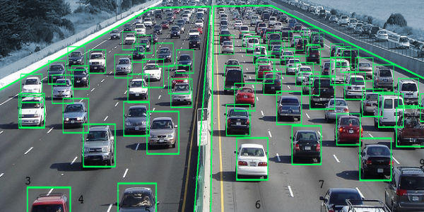
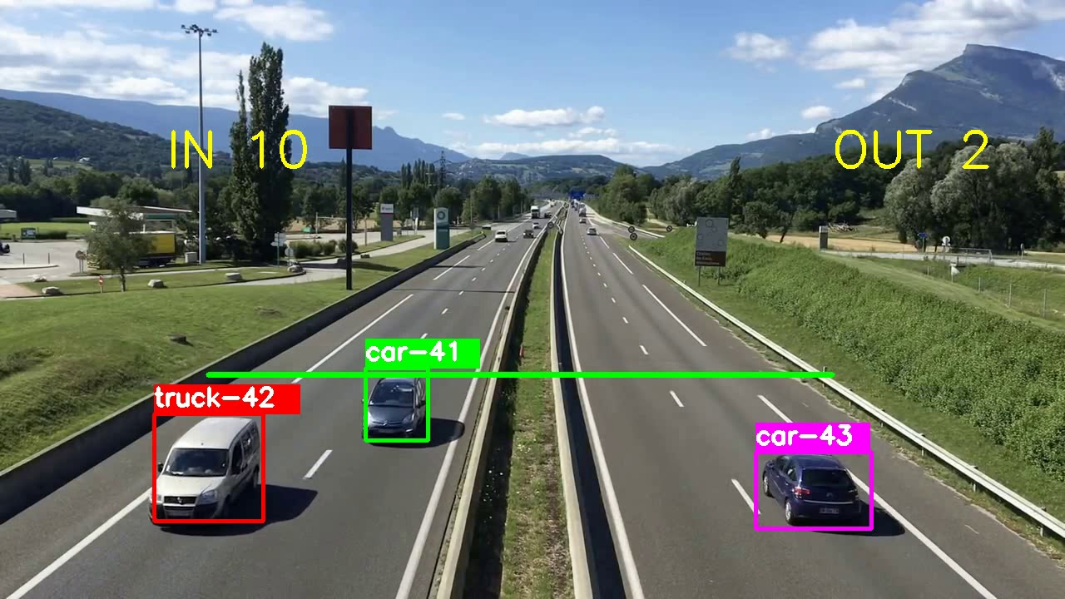
Vehicle detection using Open-cv and PYTHON
Presented by -----
Sunil kumar

Slide 2
INTRODUCTION
Vehicle detection and statistics in highway monitoring video scenes are of considerable significance to intelligent traffic management and control of the highway. With the popular installation of traffic surveillance cameras, a vast database of traffic video footage has been obtained for analysis. Generally, at a high viewing angle, a more-distant road surface can be considered. The object size of the vehicle changes greatly at this viewing angle, and the detection accuracy of a small object far away from the road is low. In the face of complex camera scenes, it is essential to effectively solve the above problems and further apply them. In this article, we focus on the above issues to propose a viable solution, and we apply the vehicle detection results to multi-object tracking and vehicle counting.

Slide 3


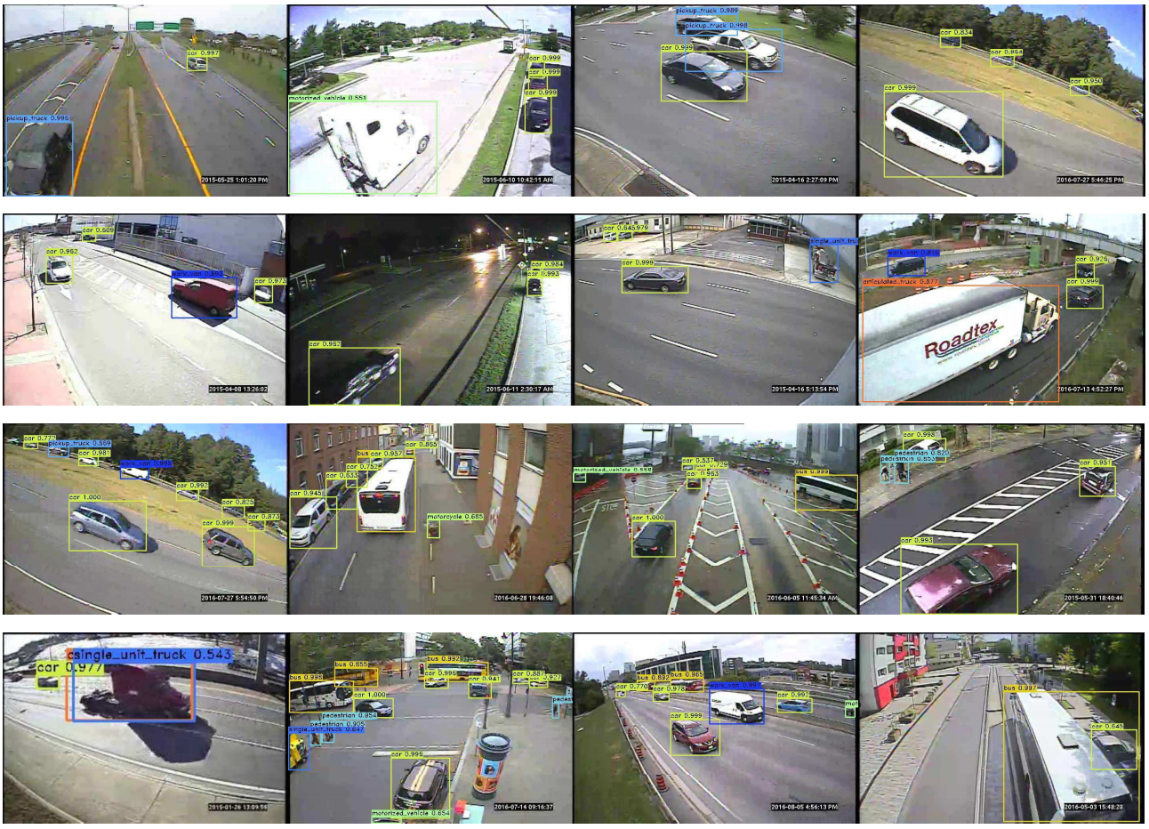
Project look like this..

Slide 4
OVERVEIW
Excited by the idea of smart cities? You’ll love this tutorial on building your own vehicle detection system
We’ll first understand how to detect moving objects in a video before diving into the implementation part
We’ll be using OpenCV and Python to build the automatic vehicle detector

Slide 5
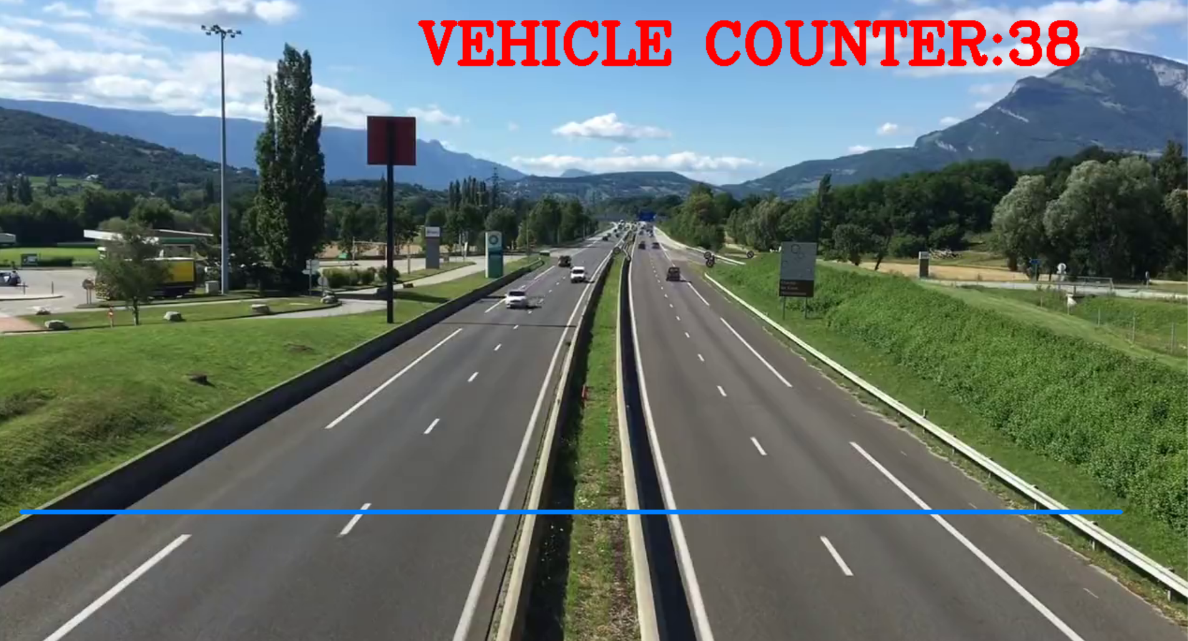

Slide 6
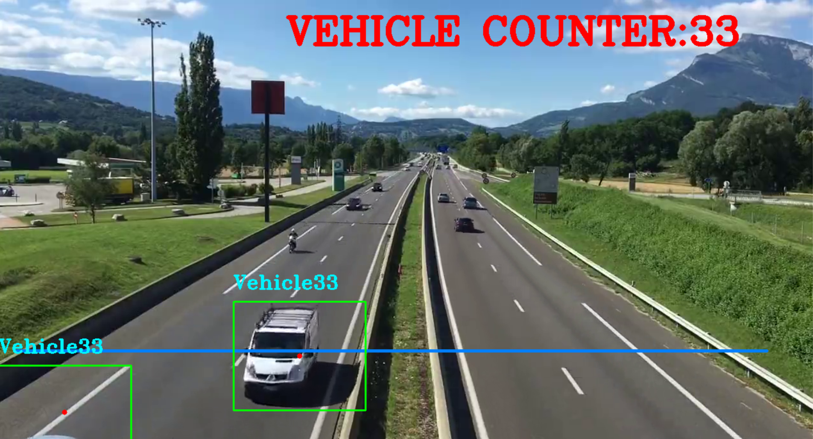

Slide 7
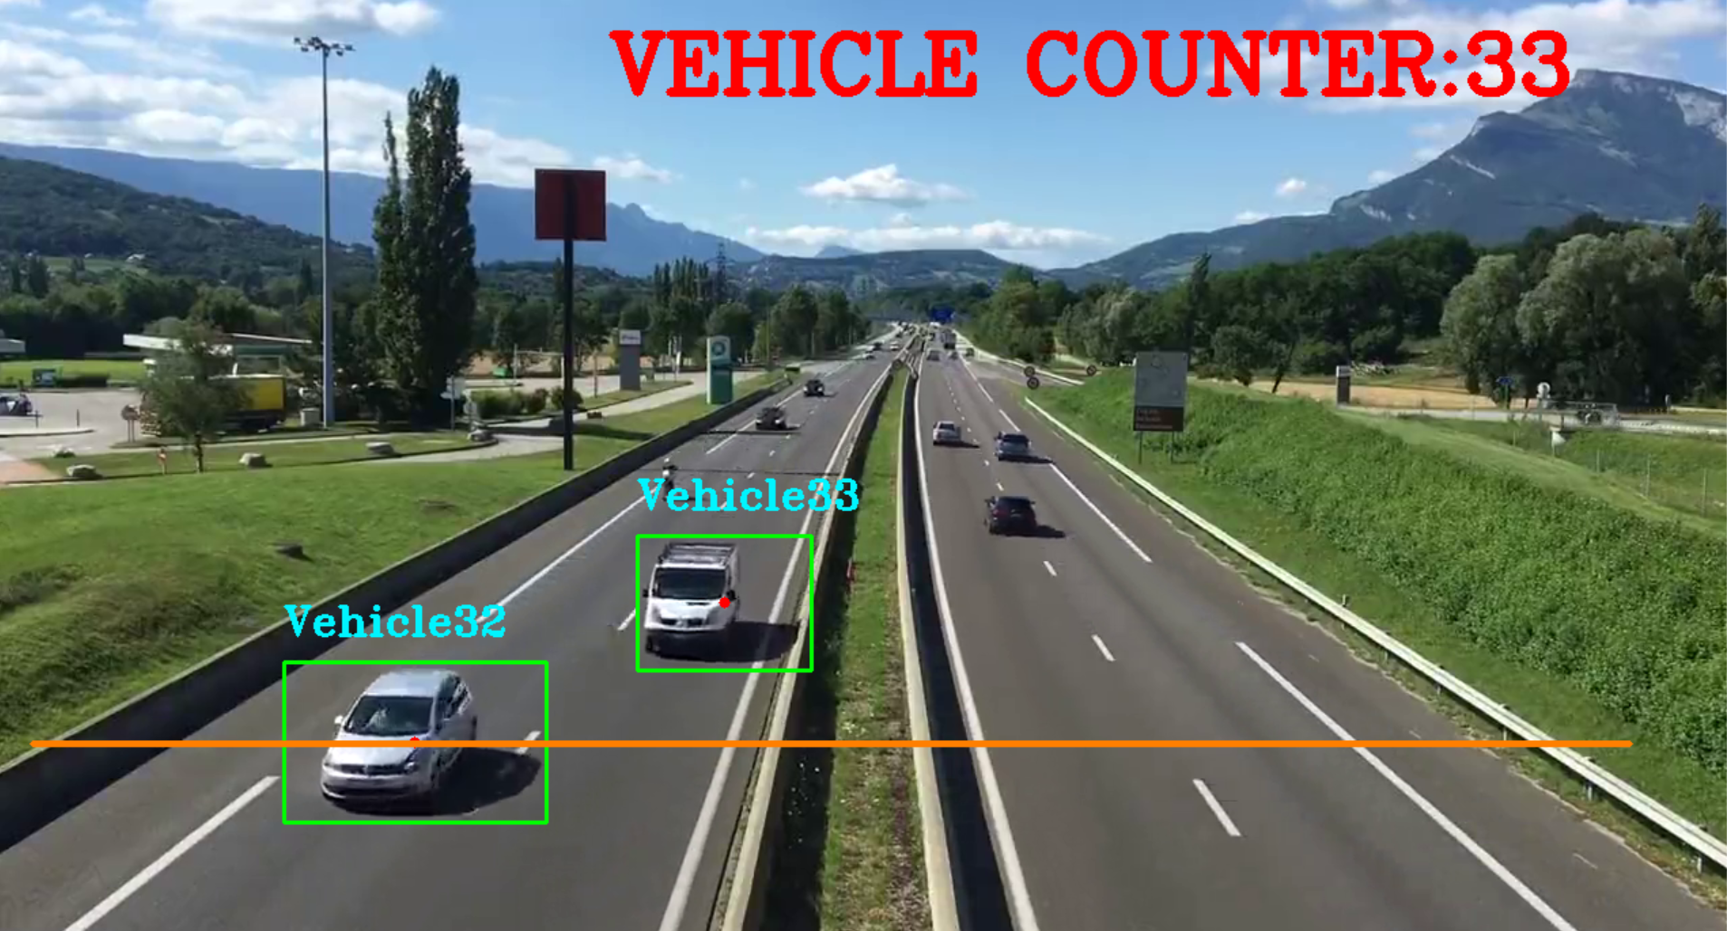

Slide 8
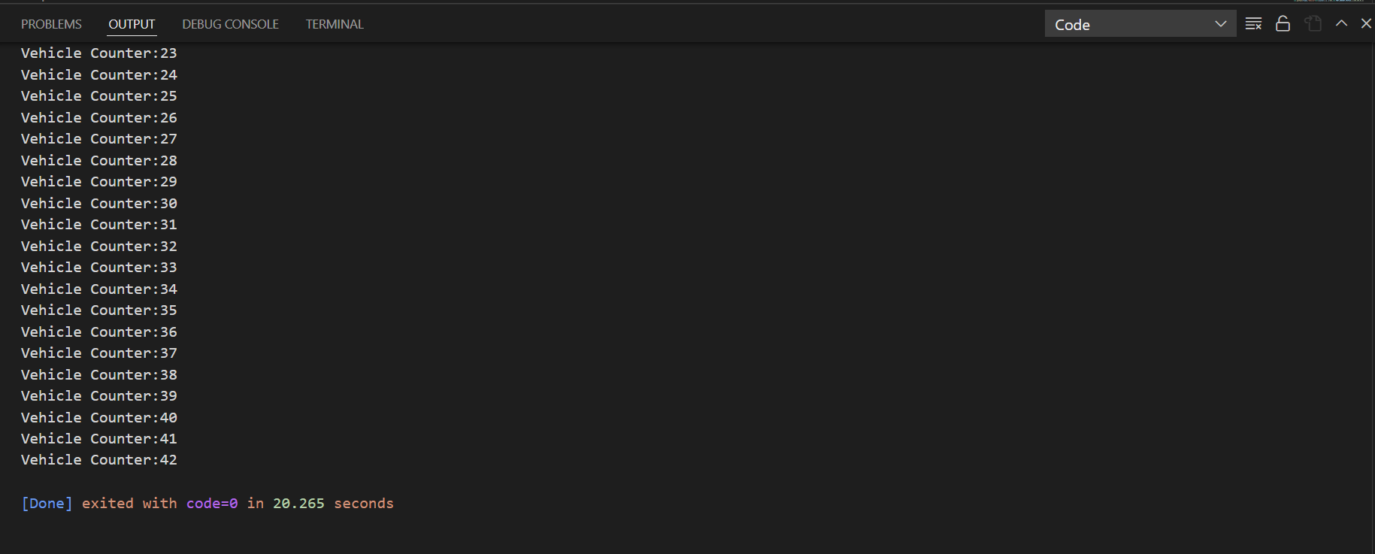

Slide 9
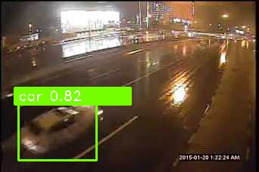
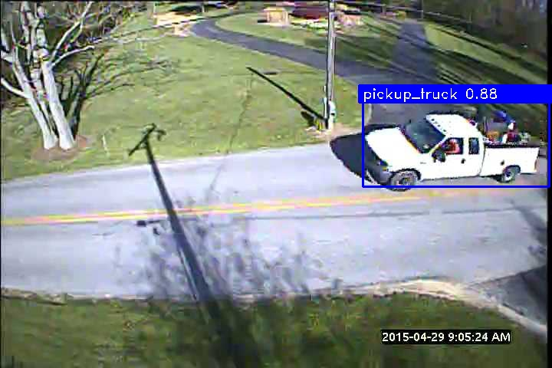
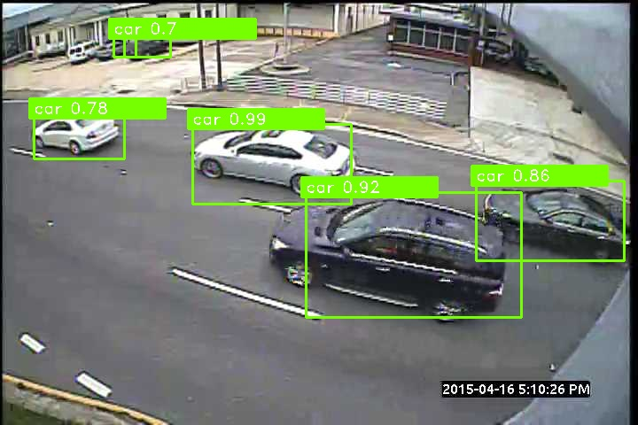
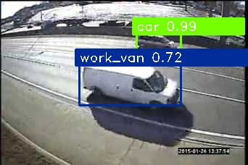
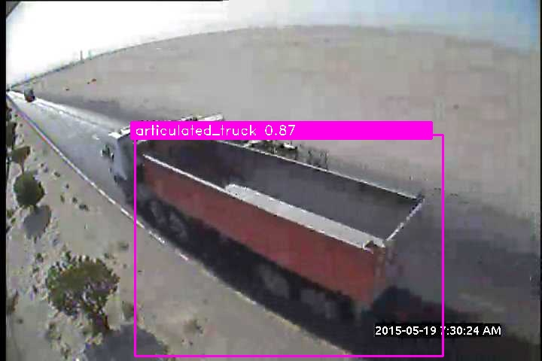
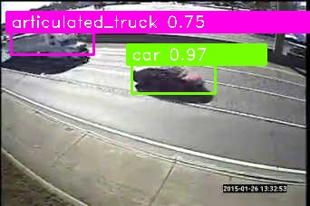
good result

Slide 10
Some bad results are..
1. Overlapping of boxes.
2. Unable to detect.
3. Incorrect detection.

Slide 11
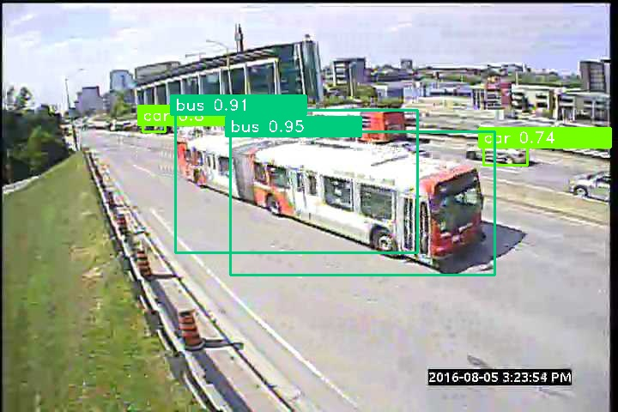
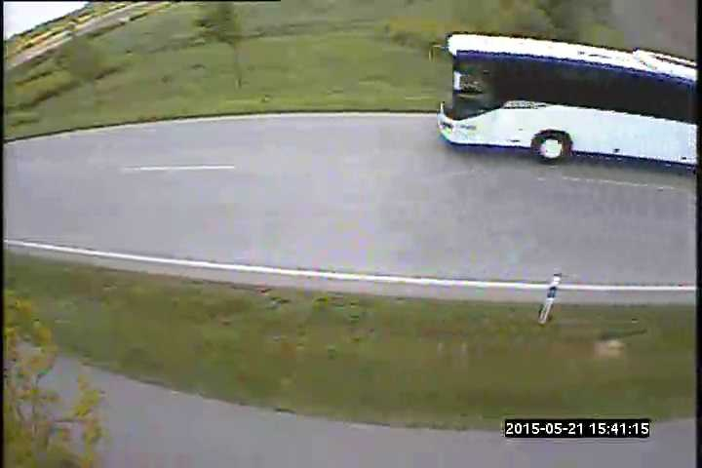
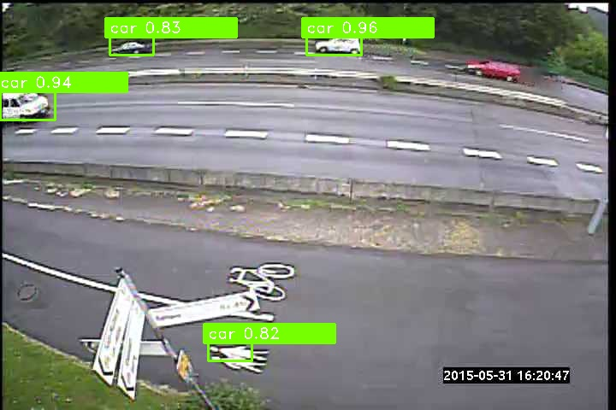
S0me bad results
Overlapping boxes
UNABLE TO DETECT
INCORRECT DETECTION

Slide 12
SCOPE
Helps traffic police: A vehicle detection and counting system could be beneficial for the traffic police because everything they can monitor from one place only likes how many vehicles have crossed this toll and which vehicle.
Traffic surveillance control: As this application can be planted anywhere as it only requires a camera or some wires (for establishing the connectivity with the central system) hence if the traffic is high at someplace, then from that area, an officer can monitor it and forward the information to next toll officer so that they could be prepared beforehand.

Slide 13
TECHNOLOGY USED
Platform: VS code.
Programming Language : Python Programming.
With the help of some library like open-cv-python 4.5.2.52 and
num-py 1.20.3
4. OS used : Windows 10

Slide 14
References
Google for Problem Solving
Head Python First : A Brain Friendly Guide
Python Crash Code , 2nd Edition
The complete guide to Python :
Link : https://pythonprogramming.net/
5. Google for images and video.

Slide 15


